Slide 1





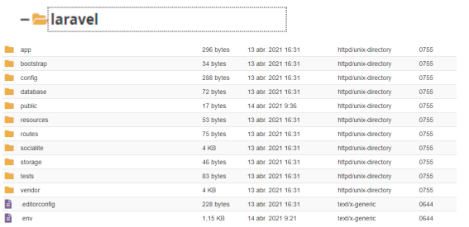

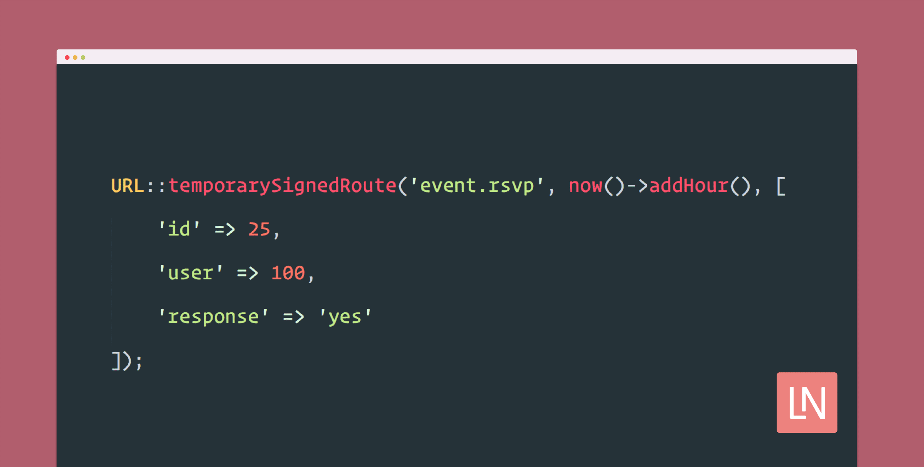

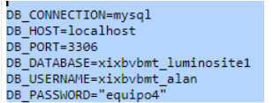
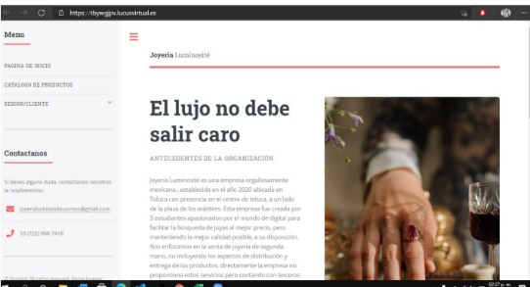

UPLOAD PROJECT TO INTERNET
UPLOAD PROJECT TO INTERNET
Alan Brayan Torres Villavicencio
Steps to upload a Laravel project to Lucushost
Step 1
Step 2
Step 3
Step 4
Step 5
Step 6
Step 7
Step 8
Unziip
Step 9
Step 10
The system is ready

